Slide 1
Planners and Planning in Your Community
A presentation created for
World Town Planning Day

Slide 2

What is a planner?
A planner is a trained professional who works to improve the quality of Ontario’s environment and communities.
Planners work for government, consulting firms, private industry, and universities and colleges.

Slide 3
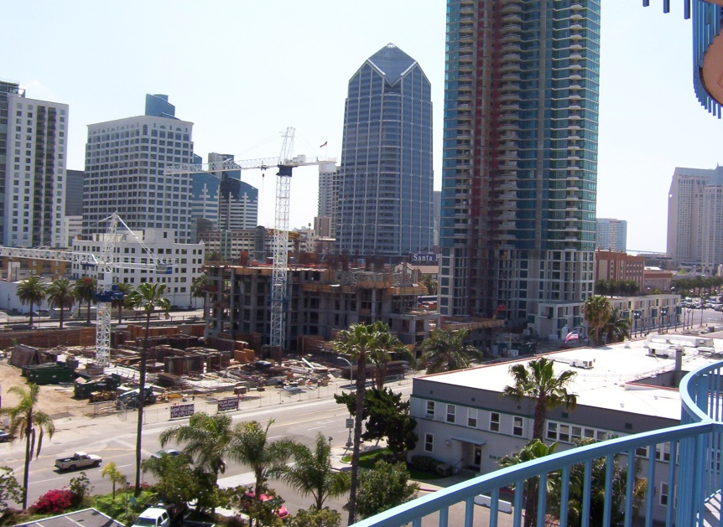
What do planners do?
Help plan and design new communities, and developments within existing communities.
Help protect the
natural environment
as well as heritage
buildings and
neighbourhoods.
Help create government
programs that benefit
individuals and communities.

Slide 4
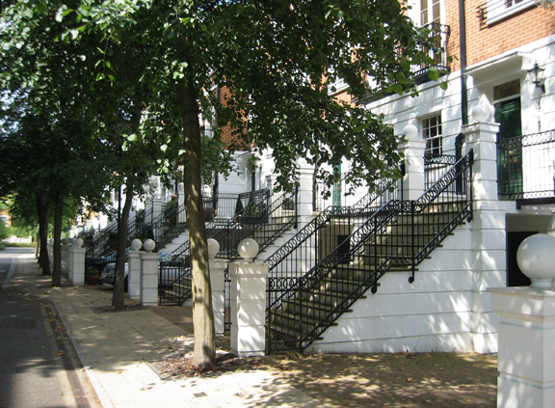
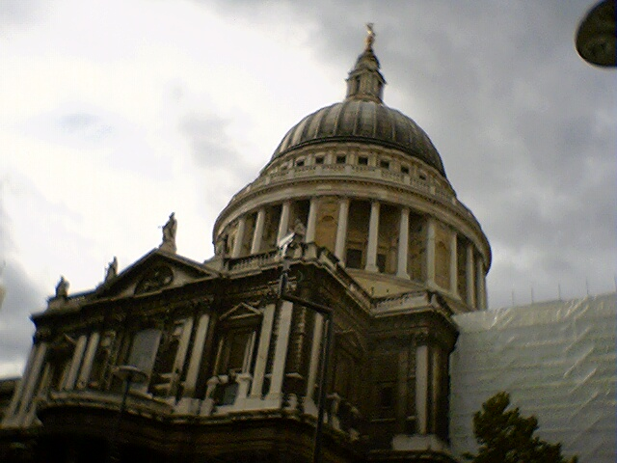
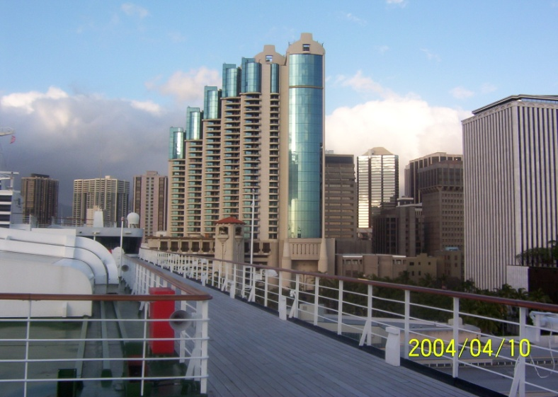
World Town Planning Day
This is an international event, intended to celebrate the accomplishments of planners in 30 countries. The first World Town Planning Day was held in 1949.

Slide 5
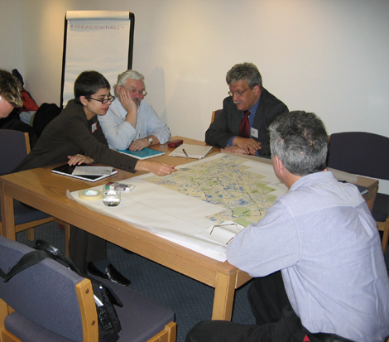
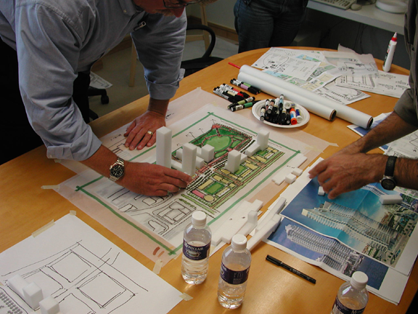
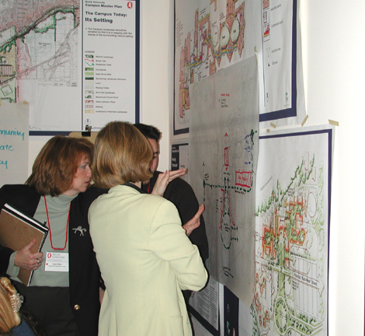
World Town Planning Day
World Town Planning Day also reminds us of the need for everyone to get involved in building communities and making policies that will improve those communities.

Slide 6
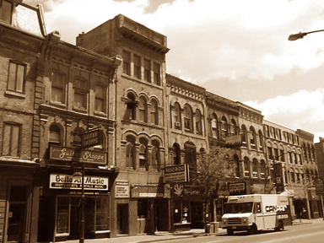
Milestones in Ontario planning
Before there were professional planners, planning was done by military surveyors, architects, engineers, landscape designers, government
officials, private
developers, and others
who decided on the
location and form of
houses, public buildings,
roads, parks, and entire towns.

Slide 7
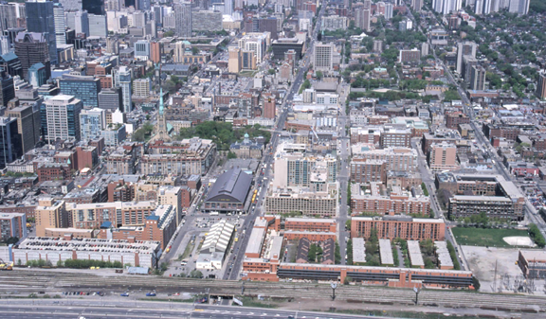
Military surveyors set the grid
In the 1790s, Ontario was largely planned by military surveyors working for Lieutenant-Governor John Graves
Simcoe. The surveyors
established the grid
of concession roads
and town lots, based
on the 66-foot
surveyor’s chain. This grid
still shapes the Ontario landscape.

Slide 8
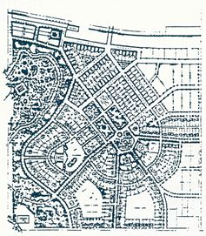
Settlers shape towns
Towns such as Guelph (1827) and Goderich (1829) were laid out in distinctive geometric patterns by
representatives of the Canada Company,
a business that opened up land for
settlement in Ontario. For example,
Goderich is built around an octagon –
an eight-sided shape with roads
radiating out in eight directions.

Slide 9
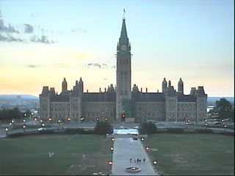
Royalty takes a hand
Queen Victoria chose Ottawa as the
capital of Canada in 1857. It was close
to Quebec, and away
from the border with
the United States.
Because it was the
capital, planning had
to begin to allow for
parliament buildings and government offices
and to create a setting for public ceremonies.

Slide 10
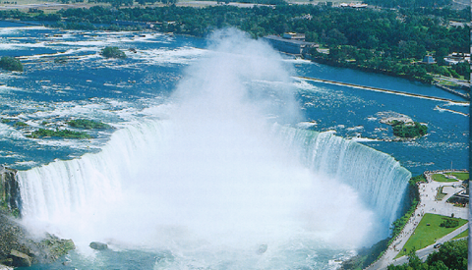

Park designers improve on nature
In 1879, Frederick Law Olmsted, an American park designer, helped prepare a plan for the park at Niagara Falls. Olmsted showed how to make natural landscapes more attractive with careful design.

Slide 11
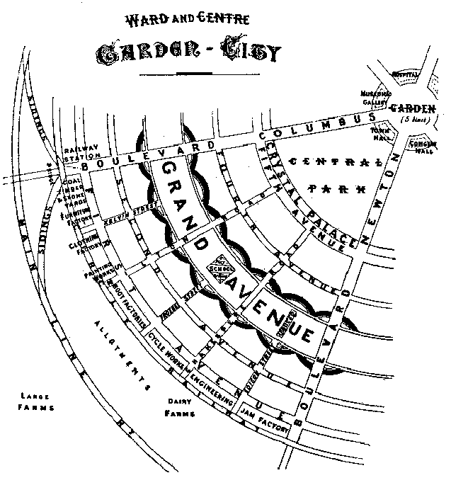
Civic leaders strive for beauty
In the 1890s, inspired by
the Paris Exhibition of
1889 and the Chicago
World’s Fair of 1893,
leading business people
and politicians worked to
make those communities
more attractive. This was known
as the ‘City Beautiful Movement’ and led
to grand plans for Toronto, Ottawa, and
Berlin (Kitchener). Few were implemented.

Slide 12

Regulators get involved
In 1906, the Ontario Railway and Municipal Board (now known as the Ontario Municipal Board) was formed. This board was created to settle disputes over planning issues and operates to this day.

Slide 13
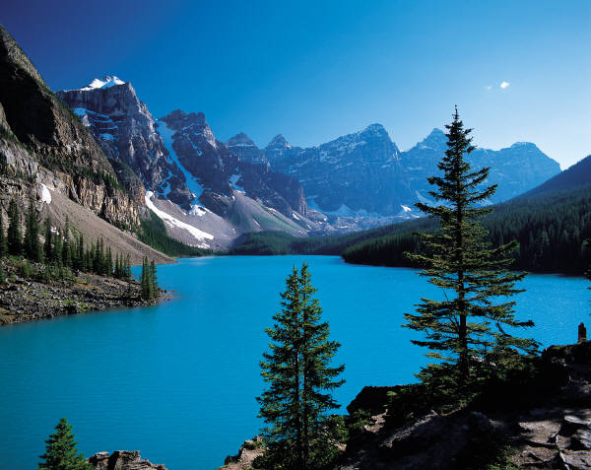
Caring for the environment
In 1909, the federal government created the Commission of Conservation, which lasted until 1921. This commission established an environmental principle that still holds true...

Slide 14
Caring for the environment
“Each generation is entitled to the interest on the natural capital, but the principal should be handed on unimpaired.”

Slide 15
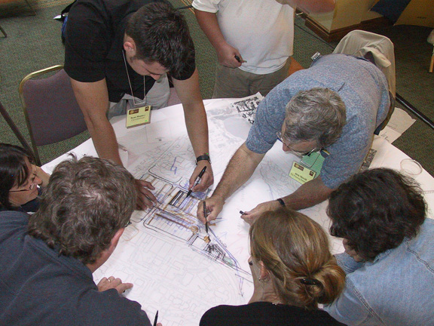
Professional planning gets started
A professional planner from Great Britain, Thomas Adams, was invited to Canada to help establish planning
here. He helped create
the Town Planning
Institute of Canada in
1919 (it lasted until
1932). The Institute
helped spread ideas
about planning.

Slide 16
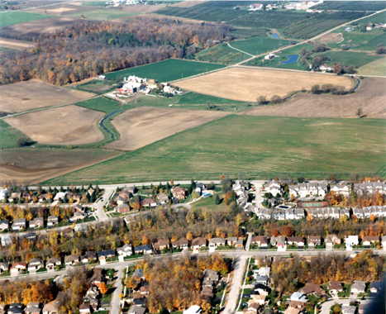
Sorting out land uses
In 1924, Kitchener became the first city in Canada to pass a
zoning by-law. It
establishes where
certain kinds of
activities can take
place in a city. Today,
all towns and cities
are divided into zones
that determine the
arrangement of land uses.

Slide 17
A new association
Humphrey Carver, an English-born town planner, and several other planners and landscape architects founded the Canadian Society of Landscape Architects and Town Planners in 1934.
Today, there are separate associations for landscape architects and planners.

Slide 18
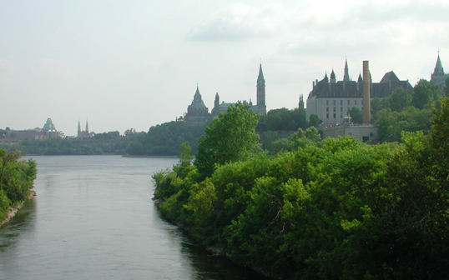
Beautifying the capital
In 1937, Prime Minister Mackenzie King invited Jacques Gréber, architect of the Paris World Exhibition of that
year, to develop plans
for Parliament Hill and
the area around it,
subsequent to the
1927 opening of the
new Centre Block
(after the fire of 1916).

Slide 19
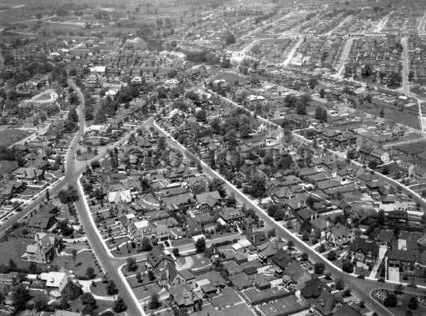
Help for housing
The National Housing Act, passed in 1938, makes it easier for Canadians to secure mortgages. After the war, this measure becomes very
important as Canada’s
population increases
rapidly with the baby
boom and immigration.

Slide 20
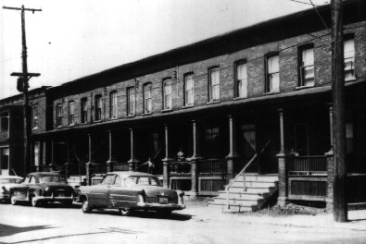
Solving problems
During the Second World War, the problems of inner-city slums and uncoordinated
suburban development
worried politicians. In
1943, C.A. Curtis and
Leonard Marsh prepare
a report intended to
guide planning for
housing once WW II ends.

Slide 21
Postwar planning
Once the war was over, there was an urgent need to build housing. In 1946, Central Mortgage and Housing Corporation (now Canada Mortgage and Housing Corporation) and the Community Planning Association of Canada were established to help finance and plan new communities, and the Ontario government passed the first Planning Act.

Slide 22
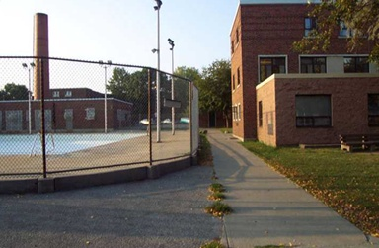
A new direction in housing
Regent Park, an area in downtown Toronto, was created as a housing project for low-income families in 1948.
It provided an alternative
to the crowded tenements
on noisy streets that had
once housed these
families. Although today it
is due to again be redeveloped, at the time it was considered an important achievement in housing.

Slide 23
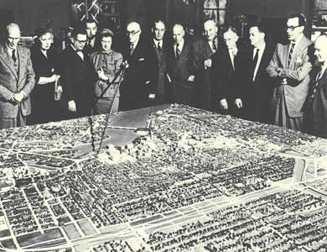
Re-inventing Ottawa
The Gréber plan for Ottawa began to reshape the central city in 1950. Railway lines and the
central station were
moved, ceremonial
and recreational parks
and driveways were
built, and a Greenbelt
was created that
surrounded the city.

Slide 24
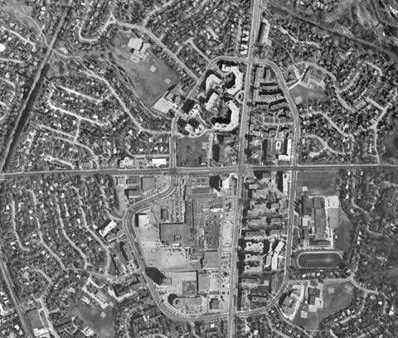
Designing suburbia
Between 1952 and 1962, Macklin Hancock, a landscape architect, planned a complete community in Don Mills,
financed by businessman
E.P. Taylor. Its curving
roads and plentiful
parks were unusual at
the time. It was very
successful and was
widely imitated by other communities.

Slide 25
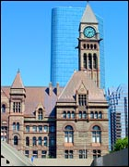
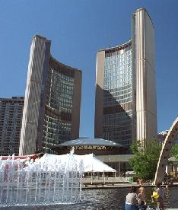
Municipal government innovation
In 1953, with the creation of
Metro Toronto, Ontario became
the first province to develop a
two-tier system of municipal
government. Metro Toronto was
able to carry out regional
planning on a large scale, and
Toronto developed an
international reputation as a
well-planned city.

Slide 26
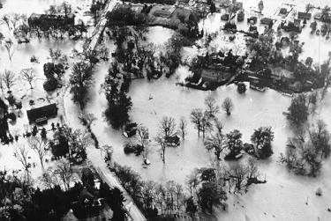
Respecting the environment
In 1954, Hurricane Hazel caused widespread flooding in southern Ontario with some loss of life. After the storm, the Ontario government
began to develop
measures to manage
water resources based
on a watershed. More
responsibility was given to
conservation authorities.

Slide 27

A new voice
Jane Jacobs, a journalist writing on urban affairs, criticized large-scale plans for urban renewal in The Death and Life of Great American Cities,
published in 1961. Her book later became
very influential in planning. In 1968, she
moved from New York to Toronto.

Slide 28
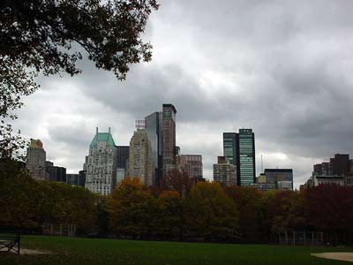

From city to metropolis
Hans Blumenfeld, a German-born planner and professor at the University of Toronto, uses the word “metropolis” to describe large diverse cities in The Modern Metropolis, published in 1967.

Slide 29


Organizing planners
The Town Planning Institute of Canada, creates four affiliated chapters in Ontario. These chapters are the forerunners of today’s Ontario Professional Planners Institute. In 1974, the Institute changed its name to the Canadian Institute of Planners.

Slide 30
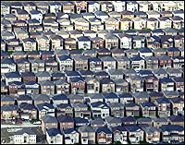
The federal government plays a role
Between 1970 and 1980, the federal government had a Ministry of State for Urban Affairs. In the
21st century, once
again, the federal
government is taking
a greater interest in
Canada’s cities and
has appointed a minister
for urban affairs.

Slide 31
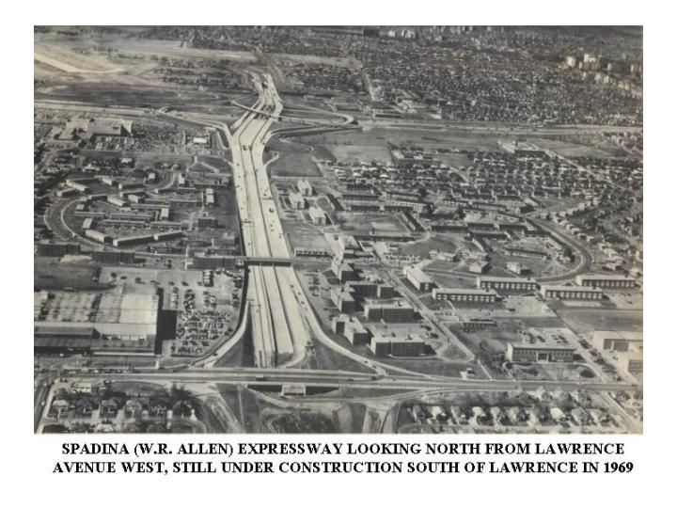
A civic victory
In 1971, Ontario Premier William Davis bowed to public pressure to stop
construction of the Spadina
Expressway, which would
have cut through many
downtown neighbourhoods.
This move was hailed as a
victory by those who think
cities are for people, not cars.

Slide 32
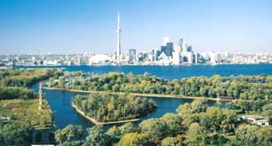
Making cities healthier
In 1986, the Healthy Cities Movement is organized by the Canadian Institute of Planners and the Canadian
Public Health
Association. This
movement continues
to lobby for a cleaner
environment and
healthier lifestyles for
residents of Canada’s cities.

Slide 33
An Ontario Institute
In 1986, the four affiliated chapters of the Canadian Institute of Planners merged to form the Ontario Professional Planners Institute. The Institute promotes good planning, ensures that members follow a Code of Conduct, conducts research on planning issues, and keeps members informed through the Ontario Planning Journal, e-communications and educational courses.

Slide 34

Reforming planning
In 1991-93, a Commission on Planning and Development reform, headed by former Toronto mayor John Sewell, talked to Ontarians in all parts of the province about their communities, and produced a report calling for amendments to legislation and planning. The government adopted many of its recommendations; many were altered when the government changed in 1995.

Slide 35
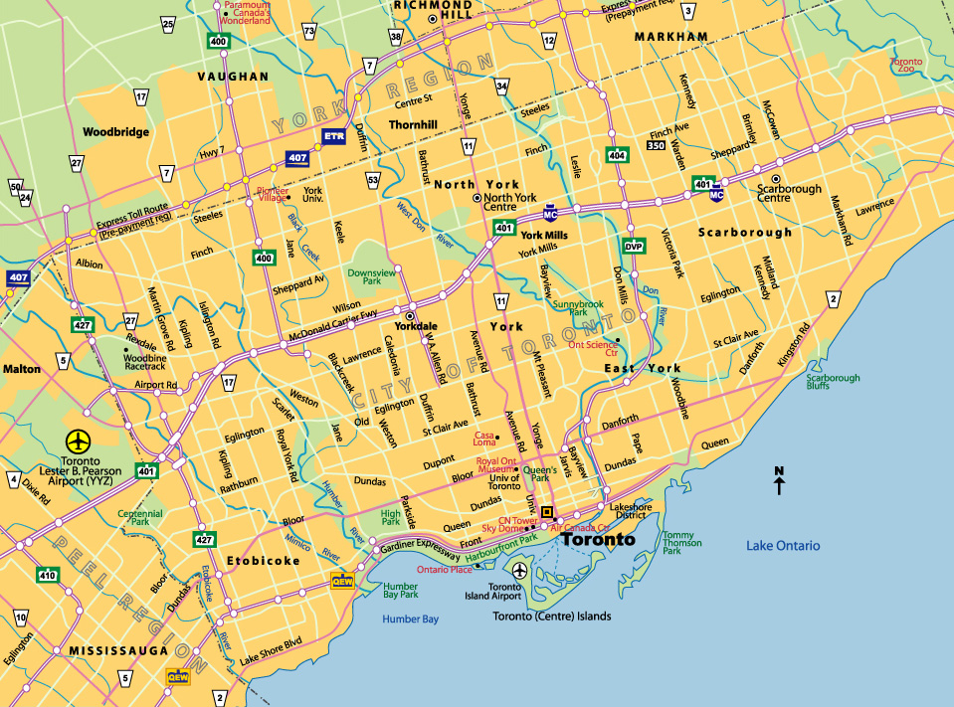
A flurry of changes
After 1995, when the Conservatives formed the Ontario government, municipalities had to take on new functions, and many municipalities were amalgamated. Before 1995,
there were more than 800 municipalities in Ontario; by
2000, there were fewer than 400.

Slide 36
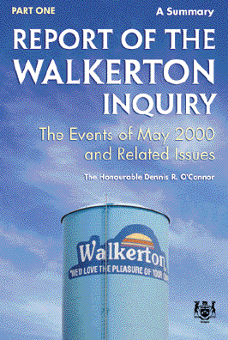
A crisis
The deaths of seven people in Walkerton, Ontario, from contaminated drinking water in May 2000 called attention to the need for careful
management of water resources.
A public inquiry leads to many
recommendations and reforms.

Slide 37
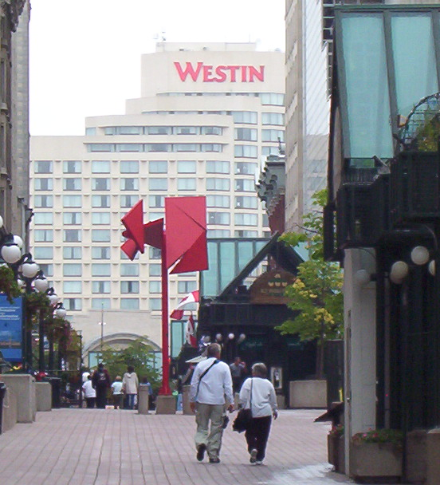
Making growth smarter
In 2001, the Ontario government launched a “Smart Growth” initiative to prevent
suburban sprawl and urban
decline, while ensuring a
healthy economy and
environment. Five Smart
Growth panels developed
recommendations intended
to help Ontario communities
become more livable and prosperous.

Slide 38
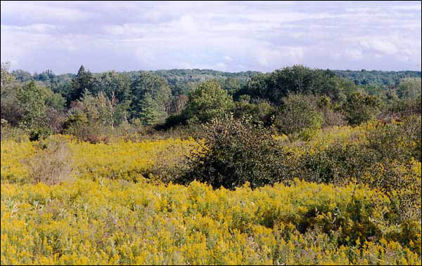
Saving the Moraine
The Oak Ridges Moraine is a 160-km-long feature stretching from the Niagara Escarpment to the Trent
River. Many of the rivers
in the area originate in
the Moraine. In 2001,
proposals for large
developments on the Moraine
met with public opposition. The Ontario government passed legislation to help protect the feature.

Slide 39
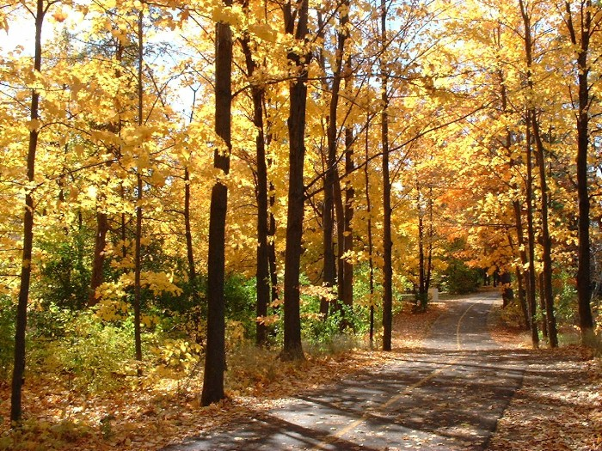
Planning Reform
In 2004, the new Ontario Liberal government proposed changes to the Planning Act, the
Ontario Municipal Board,
and the Provincial Policy
Statement, and
published a discussion
paper on regional
planning for the “Greater Golden Horseshoe” around Toronto.

Slide 40
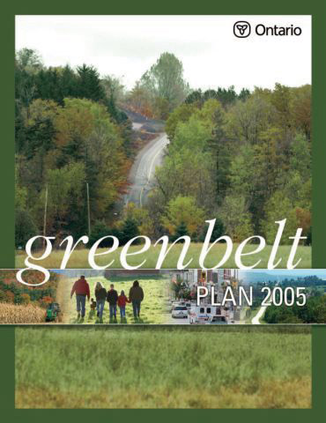
Greenbelt Act
The Greenbelt Act, 2005 enabled the creation of a Greenbelt Plan to protect about 1.8 million acres of environmentally sensitive and agricultural land in the Golden Horseshoe from urban development and sprawl.

Slide 41
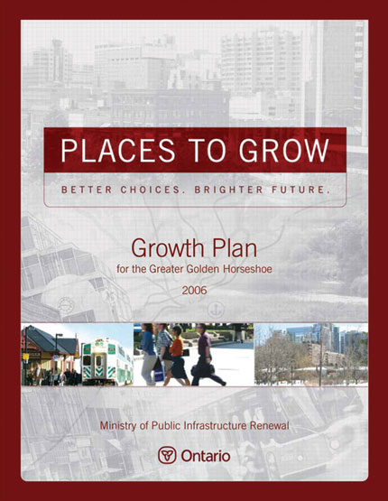
Growth Plan for the GGH
In 2006, the Province released the Growth Plan for the Greater Golden Horseshoe. This document contained the government’s vision and framework for managing growth in this region to 2031.

Slide 42
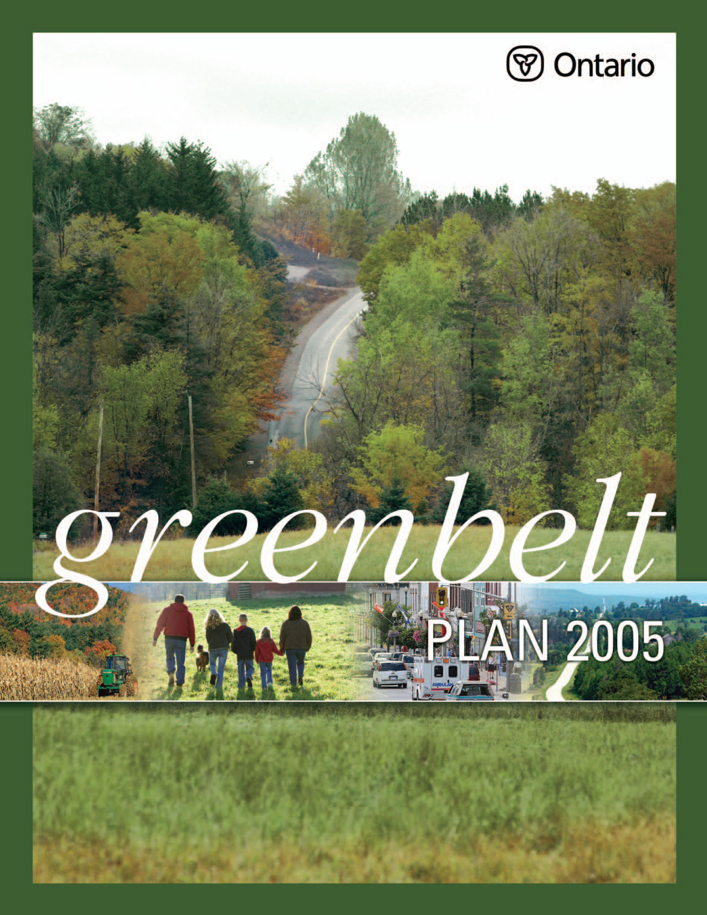
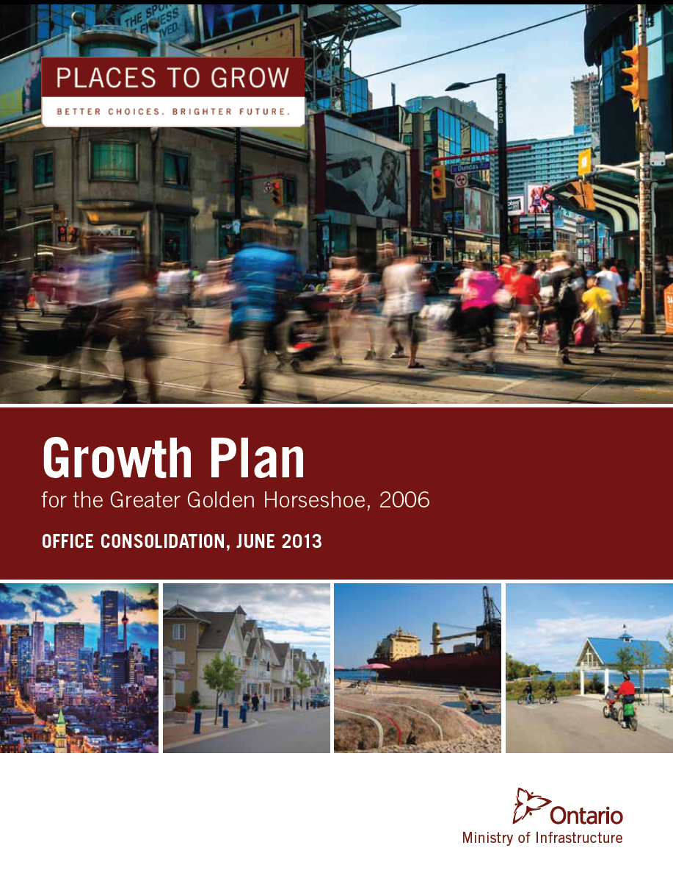
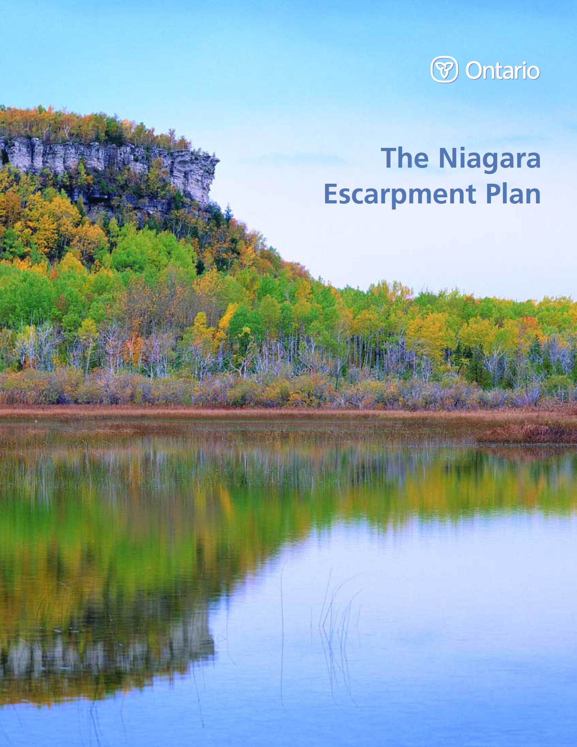
current provincial
Plan reviews

Slide 43
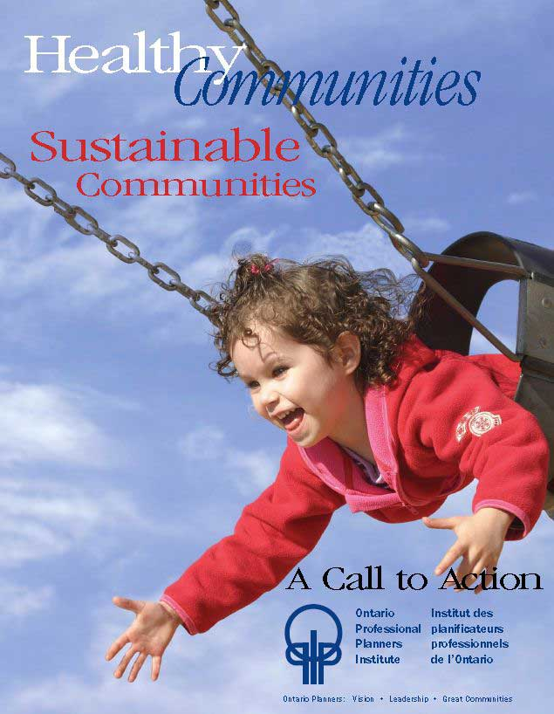
Healthy Communities,
Sustainable Communities
On November 8th 2007 OPPI released a Call to Action and Position Paper –
Healthy Communities, Sustainable Communities -
focusing on healthy and sustainable communities with an emphasis on urban design, active transportation, and green infrastructure.

Slide 44
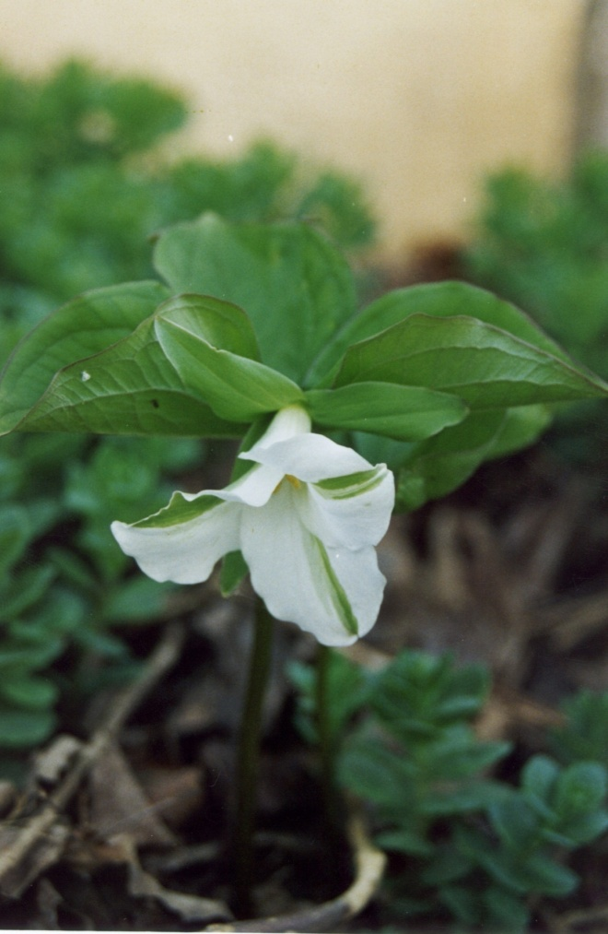
Healthy Communities,
Sustainable Communities
Since its launch, the Healthy Communities Initiative has been met with an overwhelmingly positive response.
OPPI continues to actively promote the Healthy Communities Initiative and works with many partners.
Notes:
Communities that offer opportunities for people to get out of the house (either walking to a destination, using local services, or joining in community activities) can support social cohesion and address public health issues associated with everything from obesity to mental health. But creating these inclusive communities means that residents must come together to talk about how they want their community to evolve, and how they can manage change sustainably. Decision makers need to work with community groups to create healthy, sustainable communities where all residents have a voice.

Slide 45

Healthy Communities,
Sustainable Communities
Call to Action:
Healthy Communities and Planning for the Needs of Children & Youth
(active transportation)
February 2009
Notes:
Communities that offer opportunities for people to get out of the house (either walking to a destination, using local services, or joining in community activities) can support social cohesion and address public health issues associated with everything from obesity to mental health. But creating these inclusive communities means that residents must come together to talk about how they want their community to evolve, and how they can manage change sustainably. Decision makers need to work with community groups to create healthy, sustainable communities where all residents have a voice.

Slide 46

Healthy Communities,
Sustainable Communities
Call to Action:
Healthy Communities and Planning for
Age-Friendly Communities
June 2009
Notes:
Communities that offer opportunities for people to get out of the house (either walking to a destination, using local services, or joining in community activities) can support social cohesion and address public health issues associated with everything from obesity to mental health. But creating these inclusive communities means that residents must come together to talk about how they want their community to evolve, and how they can manage change sustainably. Decision makers need to work with community groups to create healthy, sustainable communities where all residents have a voice.

Slide 47

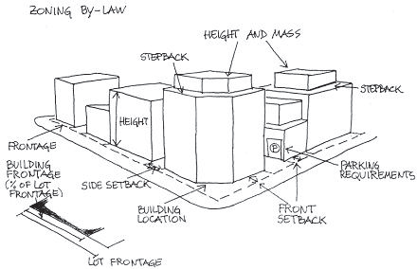
Healthy Communities,
Sustainable Communities
MAH/OPPI handbook:
PLANNING BY DESIGN: a healthy communities handbook
Released Fall 2009

Slide 48
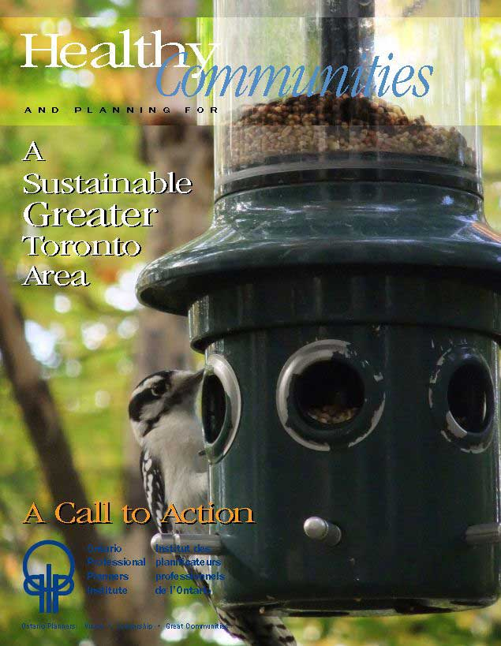
Healthy Communities,
Sustainable Communities
Call to Action:
Healthy Communities and Planning for a
Sustainable Greater Toronto Area
March 2011

Slide 49

Healthy Communities,
Sustainable Communities
Call to Action:
Healthy Communities and Planning for Food Systems in Ontario
June 2011

Slide 50
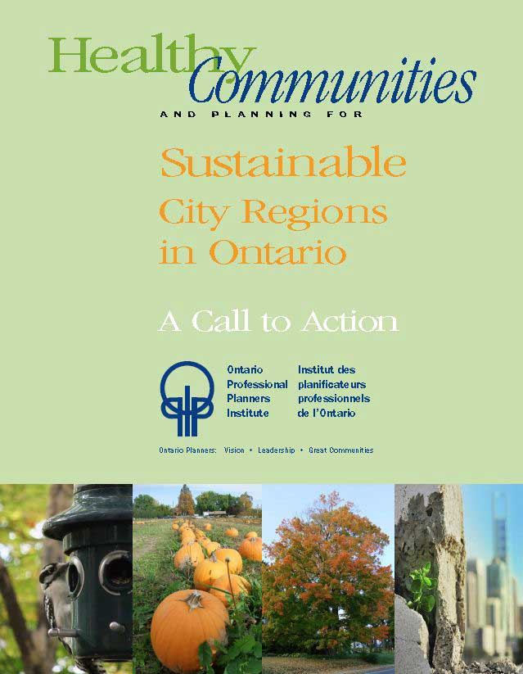
Healthy Communities,
Sustainable Communities
Call to Action:
Healthy Communities and Planning for
Sustainable City Regions in Ontario
October 2011

Slide 51
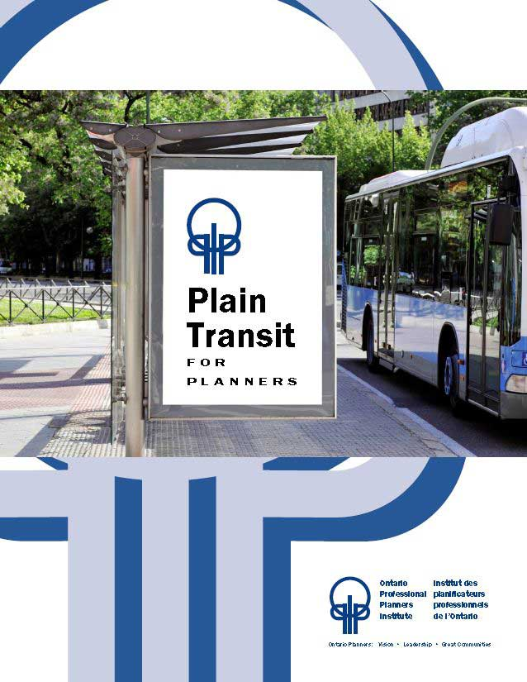
Healthy Communities,
Sustainable Communities
Plain Transit for Planners
October 2011

Slide 52
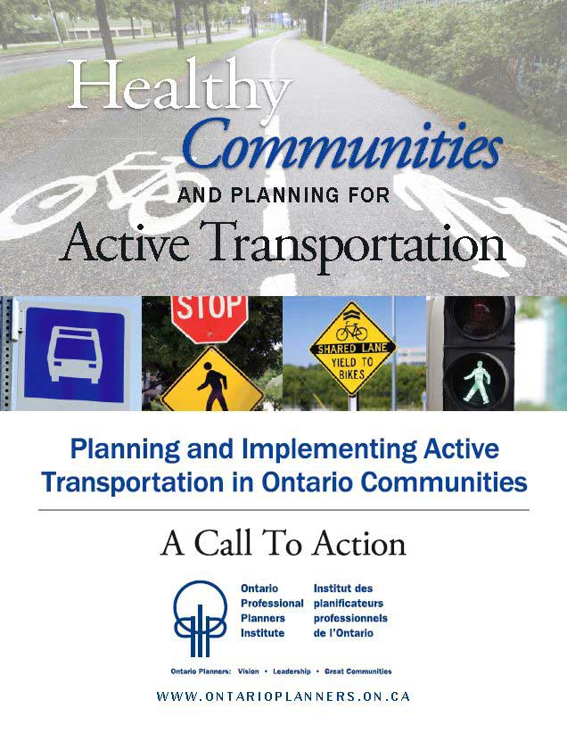
Healthy Communities,
Sustainable Communities
Call to Action:
Planning for Active Transportation
June 2012

Slide 53

Healthy Communities,
Sustainable Communities
A Call to Action:
Healthy Communities and Planning for Active Transportation: Moving Forward on Active Transportation in Ontario’s Communities
March 26, 2014

Slide 54
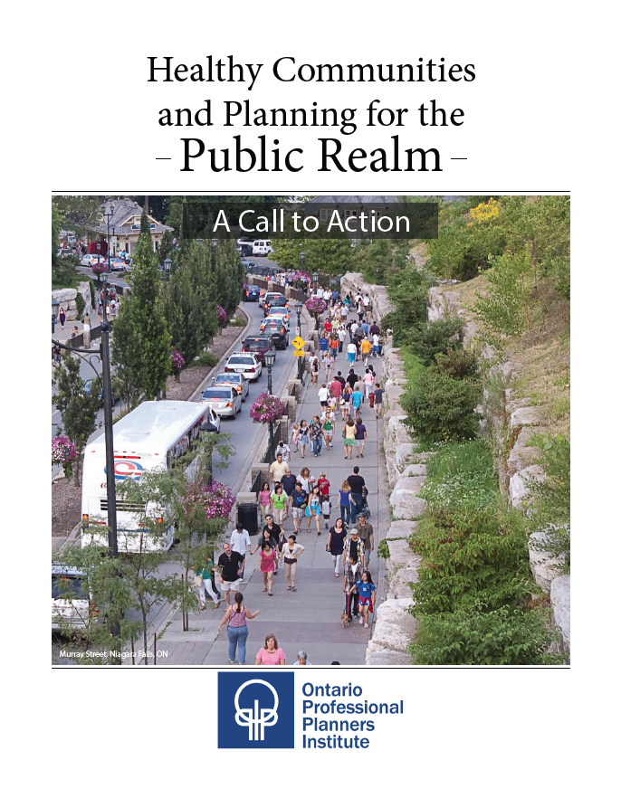
Healthy Communities,
Sustainable Communities
A Call to Action: Healthy Communities and Planning for the Public Realm
November 10,2016

Slide 55
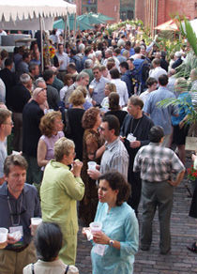
What do you think?
We’ve shown the many ways in which Ontario has been shaped by those who have planned communities and government policies and some of OPPI’s key policy initiatives. At the same time,
changes in the way people
work, where they come from
and live, as well as, how they
get around, shop, play, and
study call for new kinds of
planning.

Slide 56
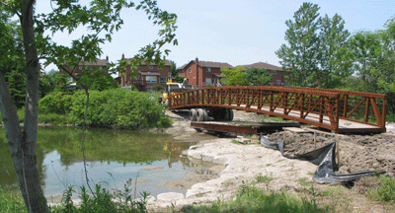
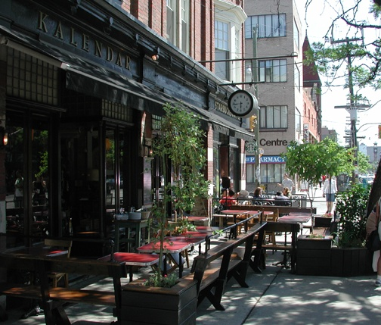



What do you think?
What are some of the challenges of planning today?

Slide 57
Who planned your community?
We’ve mentioned only a few in this overview. What do you know about the planning of your own community? Why does it look the way it does? How do you think it will look 20 years from now?

Slide 58






Where you can find out more
Six Ontario universities offer accredited planning programs:
Guelph, Queen’s, Ryerson, Toronto, Waterloo and York.

Slide 59
Where you can find out more
If you are interested in planning, you can find out more about it from:
Ontario Professional Planners Institute
www.ontarioplanners.ca
or
Canadian Institute of Planners
www.cip-icu.ca

